Slide 3
Agenda
Water
Health
Future Growth
Contaminated
DNR response
Pushing the Federal Government
Master Plan Review
Lots sizes
How to protect the rural area

Slide 4
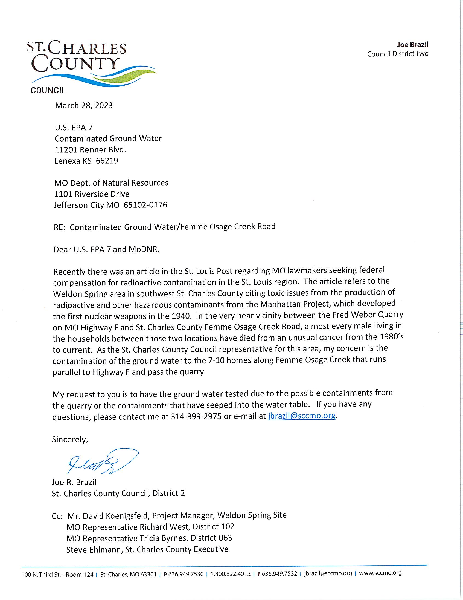

Slide 5
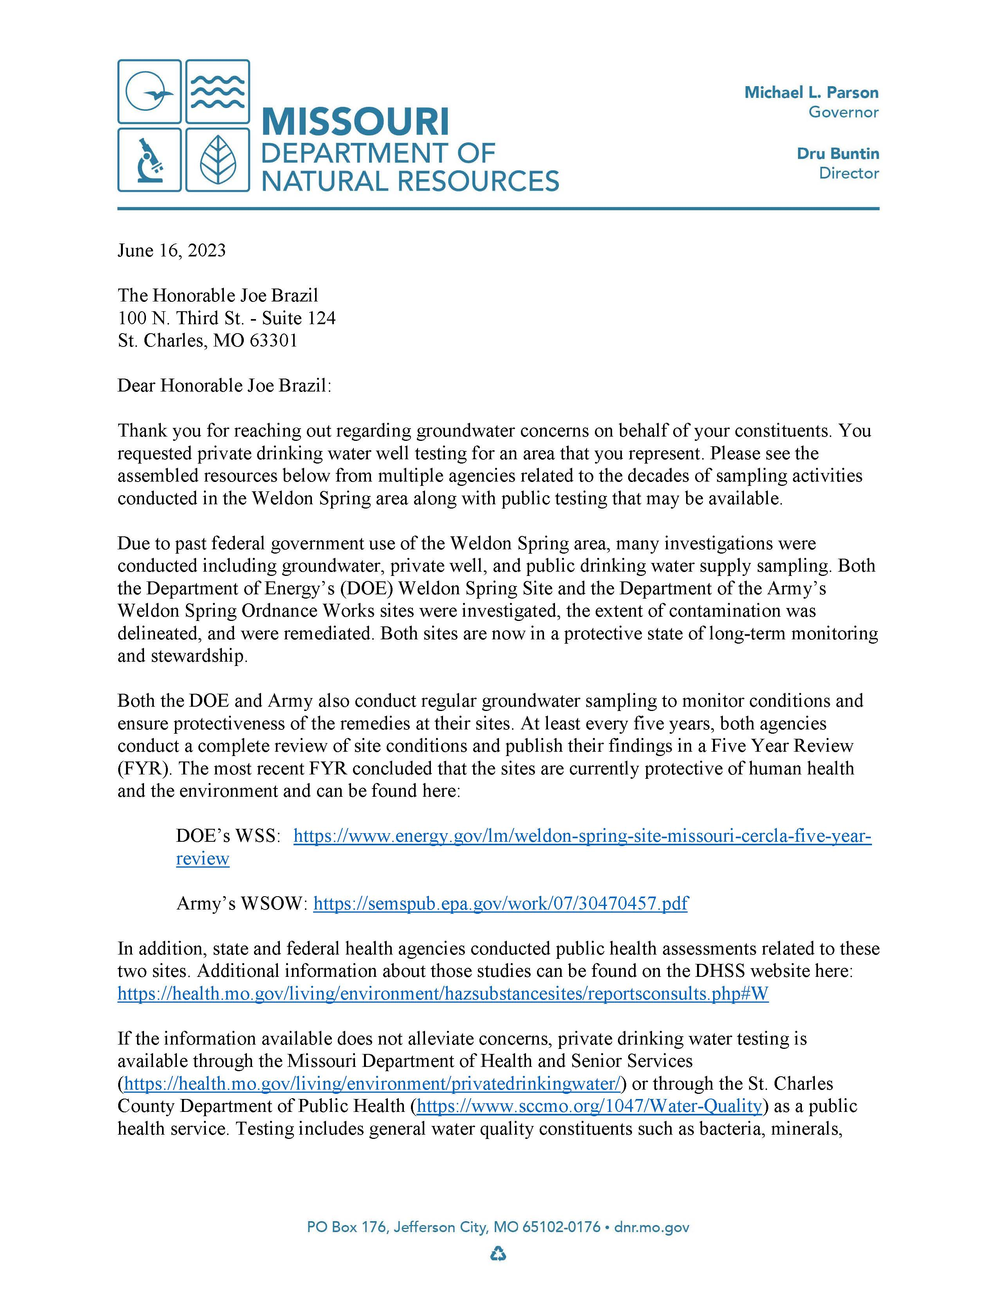

Slide 6
Introduction of Tricia Byrnes
State Representative Tricia Byrnes, District 63, has fought for victims of Manhattan Project in Weldon Springs and Cold Water Creek waste since 2018. She has repeatedly called on the Federal Government to establish more monitoring, expedited remediation, and health care for the victims of our region. In her first term as a state legislator, last session, Tricia sponsored legislation regarding these issues, which passed the Missouri House of Representatives with a unanimous vote.
Advocate and Representative, Tricia Byrnes from Wentzville.

Slide 7
2017-19 = 1,353 2020-22 = 3,425 154% Growth in last 3 years
Apartment Growth

Slide 8
Taxes paid on $300,000, $600,000, $900,000

Slide 9
Tax Impact of Apartments in St. Peters Total taxes collected per unit is $,1650.00

Slide 10
Cost Per Student
Francis Howell $11,668 per student
Wentzville $16,792 per student

Slide 11
How many children are in each household?
In 2022, there was
an average of 1.94
children under 18 per
family in the United
States.

Slide 12
Affordable Housing Online – 33 options that accept Section 8 Vouchers
6 in Dardenne Prairie
3 in O’Fallon
5 in St. Charles City
11 in St. Peters
8 in Wentzville

Slide 13
Master Plan – to control growth in county
Next revision in 2024
Revised every 5 years

Slide 14
2030 Master Plan

Slide 15
71.012, 71.014, 71.015 RSMo State Statutes – Annexation
71.012
Contiguous & compact
Notarized petition requesting annexation by owners of the property
Public hearing is held – evidence presented.
City determines that the annexation is reasonable and necessary to the proper development of the city, it can annex the land by ordinance.
Written objection to the proposed annexation is filed w/ city no later than 14 days from the Public Hearing by at least 5% of the qualified voters of the city.

Slide 16
71.012, 71.014, 71.015 RSMo State Statutes – Annexation
71.014
May annex unincorporated areas which are contiguous and compact to the existing corporate limits upon notarized petition requesting such annexation signed by the owners of all fee interests of record in all tracts located within the are to be annexed.
This requires the 15% compact and contiguous.

Slide 17
71.012, 71.014, 71.015 RSMo State Statutes – Annexation
71.015 – City shall propose an ordinance setting forth the following:
City has already adopted a Resolution to annex.
The area to be annexed must be 15% compact and contiguous.
Annexation is reasonable and necessary to proper development of city.
The city has developed a plan to provide services to the annexed area.
Hold a public hearing prior to the adoption of the ordinance.
File a Declaratory Judgement lawsuit in Circuit Court to authorize the annexation.
Hold an election of the city registered voters.
2/3 majority must be in approval.

Slide 18
Questions to consider:
Do we want cities to aggressively annex unincorporated areas for high density housing?
Do we want apartments and more 7,000 sq. ft. lots?
Do we want to urbanize the whole County?
Do we want proper growth to maintain the rural and cultural agricultural areas of the County?

Slide 19
Questions to consider:
How do we protect the rural area?
Change State annexation laws
Create a City of Defiance to maintain existing lot sizes and require 5-acre minimum lots
Should New Melle and Augusta do the same

